Slide 1
FieldChartOCR
Extraction of Handwritten Charts and Tables
DD/MM/YYYY
Feature Name/Product
Your Company Name

Slide 2

Introduction
This presentation summarizes the FieldChartOCR project, focusing on extracting and digitizing handwritten charts and tables. It addresses the challenges faced in manual chart digitization and outlines a novel solution. Later in the presentation, next steps are presented. The goal is to provide a clear overview for supervisory-level stakeholders on project motivation, approach, and evaluation plans.
DD/MM/YYYY
Feature Name/Product
Your Company Name

Slide 3
00
Project Introduction

Slide 4
Project Name, Presenter, Date
FieldChartOCR: Extraction of Handwritten Charts and Tables
Presented by Chris Brechin
Date: December 6th, 2025
DD/MM/YYYY
Feature Name/Product
Your Company Name

Slide 5
Motivation and Problem Statement
Digitizing handwritten charts is difficult due to varied handwriting styles, inconsistent layouts, and noise in scanned images. Manual transcription is slow and error-prone, causing significant pain points for data accessibility and analysis. FieldChartOCR aims to automate this process, improving accuracy and efficiency in converting handwritten visual data into machine-readable formats.
DD/MM/YYYY
Feature Name/Product
Your Company Name

Slide 6
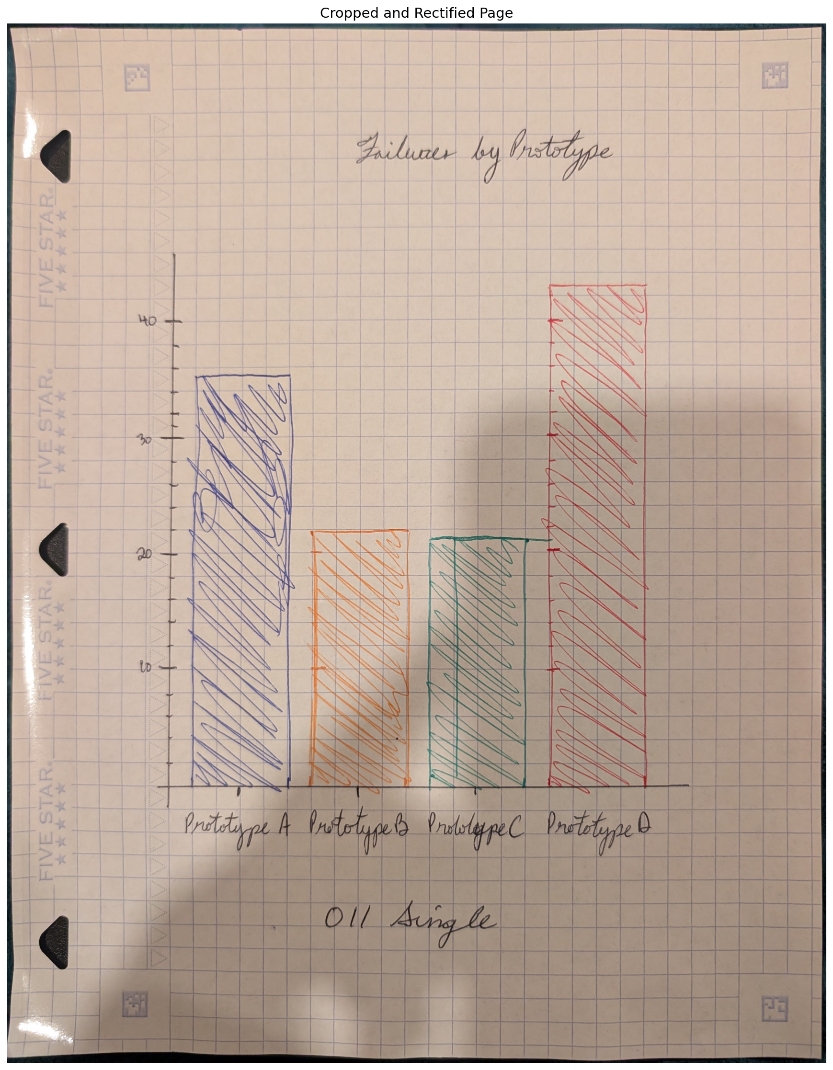
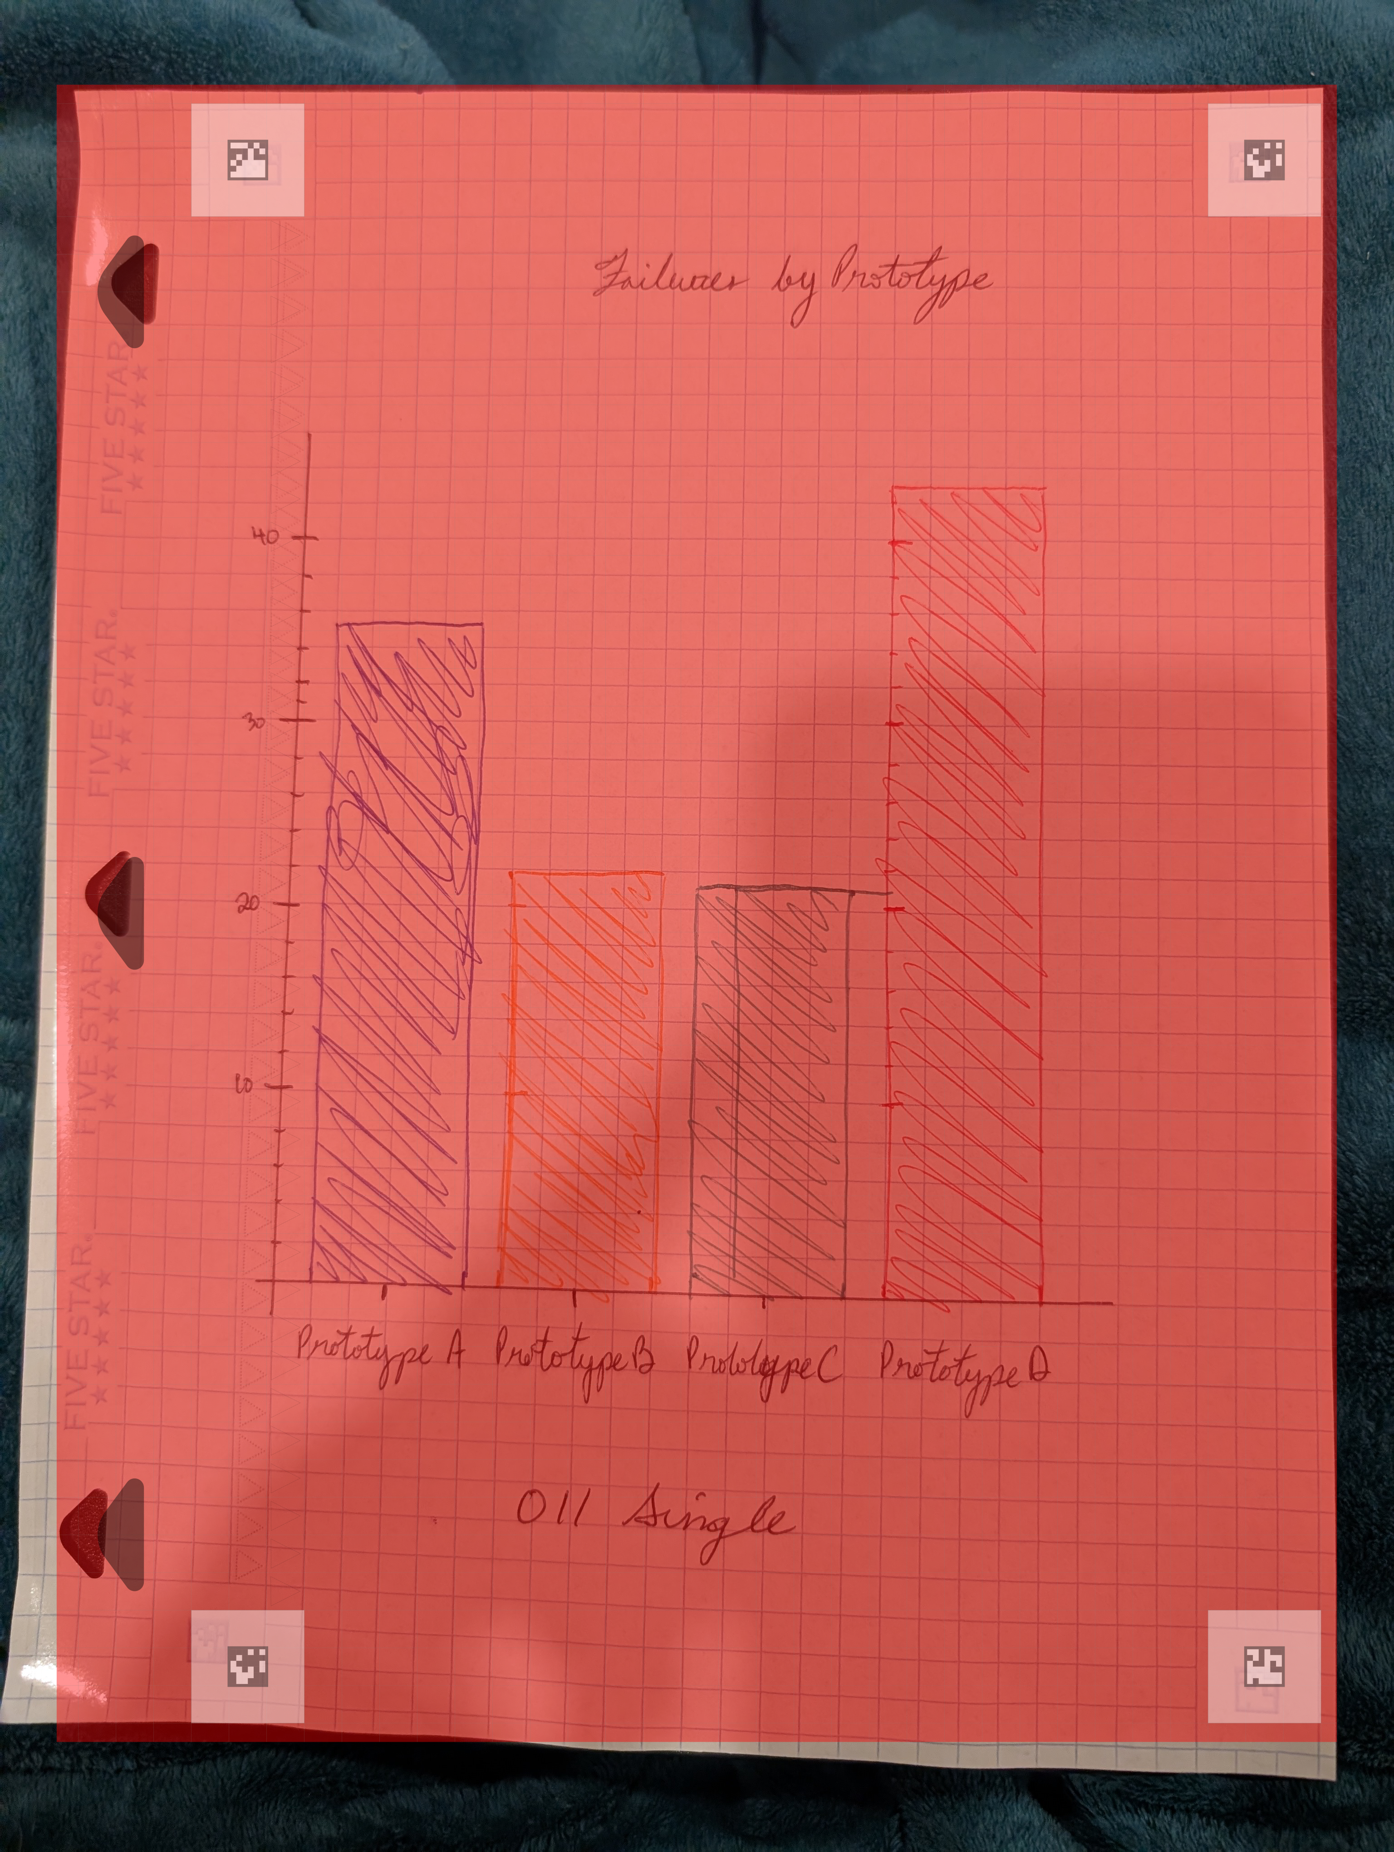
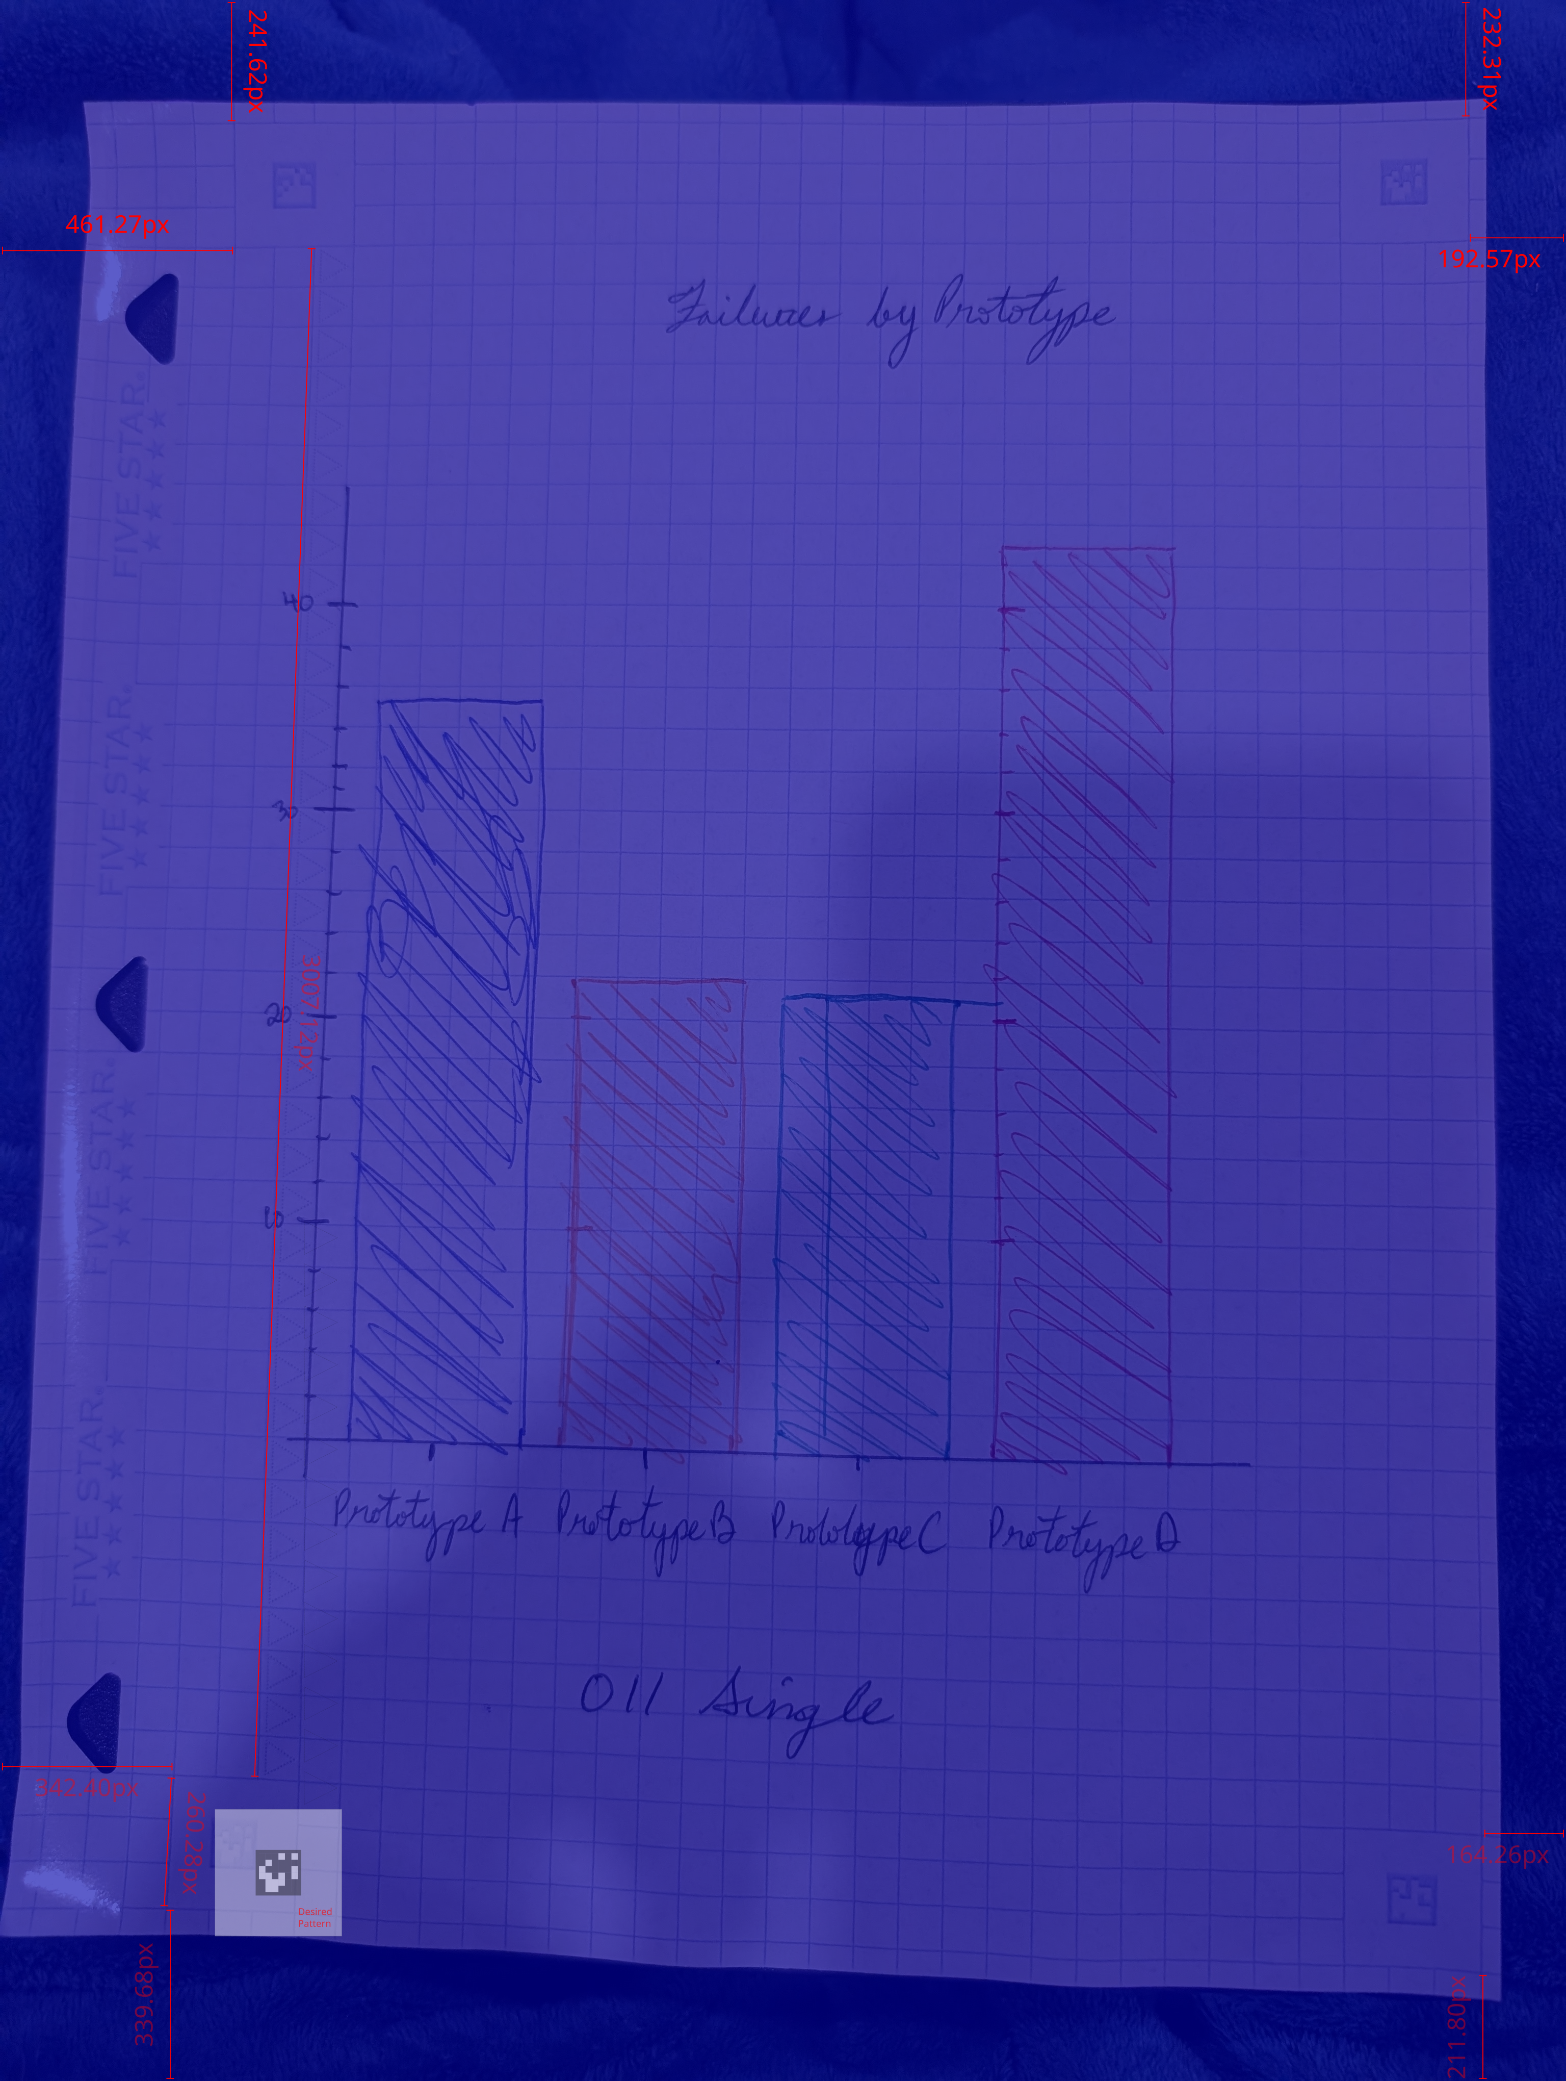
Key Challenges in Digitizing Handwritten Charts
Update
Handwritten charts are challenging to digitize due to inconsistent handwriting, diverse chart formats, and image noise. These factors lead to difficulties in automated recognition and interpretation. The lack of standardization increases error rates, making manual transcription time-consuming and costly. Addressing these challenges requires robust pre-processing, classification, and OCR techniques tailored specifically for handwritten data.
This project was substantially more difficult than previously imagined. I decided to limit the digitization efforts to only bar charts. This was done to allow me to build one pipeline for at least one kind of data.
Examples:
1. Coded Timesheet
2. Sparse, Coded Timesheet
3. Table with mixed, float and integer values
4. Table with mixed, string and integer values
5. Checklist
DD/MM/YYYY
Feature Name/Product
Your Company Name

Slide 7
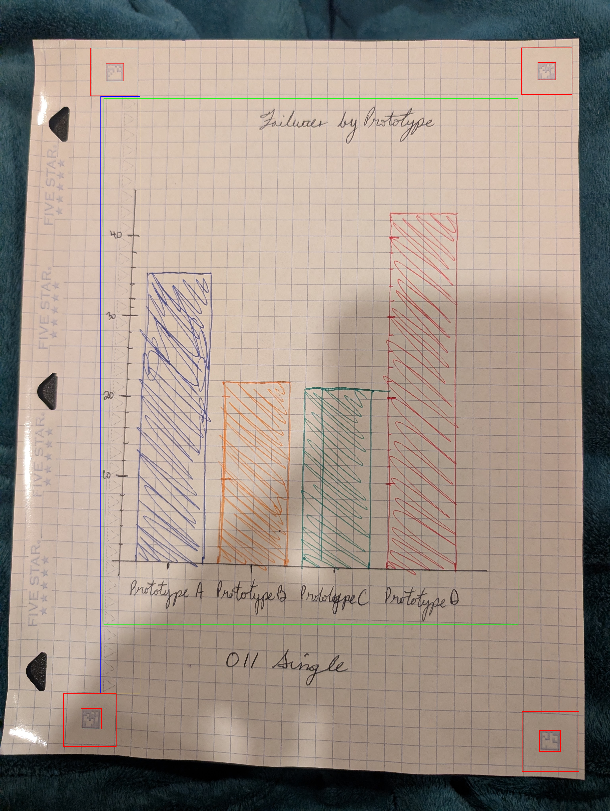
Key Challenges in Digitizing Handwritten Charts: Outlining the Problem
The goal was originally to translate all notes into digital form. I had thought of different types of notes that I write for my work.
I decided on limiting it to a simple type, bar charts. This seemed like a good starting point because of the clarity of the barchart object.
DD/MM/YYYY
Feature Name/Product
Your Company Name

Slide 8
Key Challenges in Digitizing Handwritten Charts: Outlining the Problem
Some of the reasons I thought this would be easy:
- there are colours that are easily distinguishable
- the axes can follow straight lines
- minimal character recognition work to extract
- predictable form
DD/MM/YYYY
Feature Name/Product
Your Company Name

Slide 9
01
Related Works

Slide 10
Literature Review
1. Liu, X., Chen, L., Wei, Y., Luo, Y., Zhang, H., & Zhou, S. (2021). ChartOCR: Data extraction from chart images via a deep hybrid framework. WACV 2021. https://openaccess.thecvf.com/content/WACV2021/papers/Luo_ChartOCR_Data_Extraction_From_Charts_Images_via_a_Deep_Hybrid_WACV_2021_paper.pdf
2. Savva, M., Kong, N., Chhoun, C., Agrawala, M., & Heer, J. (2011). ReVision: Automated classification, analysis, and redesign of chart images. UIST ’11, 393–402. https://doi.org/10.1145/2047196.2047247
3. Jung, D., Kim, W., Song, H., Hwang, J.-I., Lee, B., Kim, B., & Seo, J
. (2017). ChartSense: Interactive data extraction from chart images. CHI ’17, 6706–6717. https://www.microsoft.com/en-us/research/wp-content/uploads/2017/02/ChartSense-CHI2017.pdf
4. Rowtula, V., Oota, S. R., & Jawahar, C. V unavailable). https://cvit.iiit.ac.in/images/ConferencePapers/2019/PID6008523.pdf
5. Huang, K.-H., Chan, H. P., Fung, Y. R., Qiu, H., Zhou, M., Joty, S., Chang, S.-F., & Ji, H. (2024). From pixels to insights: A survey on automatic chart understanding in the era of large foundation models. IEEE Transactions on Knowledge and Data Engineering. https://arxiv.org/pdf/2403.12027v4
6. Li, Z., et al. (2024). Improving handwritten mathematical expression recognition via integrating convolutional neural network with transformer
and diffusion-based data augmentation. IEEE Access. https://www.researchgate.net/publication/380548640_Improving_Handwritten_Mathematical_Expression_Recognition_via_Integrating_Convolutional_Neural_Network_with_Transformer_and_Diffusion-Based_Data_Augmentation
DD/MM/YYYY
Feature Name/Product
Your Company Name

Slide 11
02
Technical Approach and Planning

Slide 12
Overview of FieldChartOCR Solution
FieldChartOCR employs a modular approach combining preprocessing, classification, and detection models. It will integrate OCR tailored for handwriting, alongside semantic assembly modules that reconstruct charts and tables accurately. I aim to automate the extraction pipeline, significantly reducing manual effort while maintaining high accuracy in digitizing complex handwritten visual data.
Training
Validation
Photo Normalization
DD/MM/YYYY
Camera Images
Corresponding Digital Charts
Chart Type Classification
OCR
Comma Separated Lists with tabulated data
Element Recognition
Information Extraction

Slide 13
System Architecture and Processing Pipeline
The pipeline consists of four key stages:
1. preprocessing to enhance image quality;
2. classification to identify chart types;
3. detection and OCR to extract handwritten text and graphical elements; and
4. semantic assembly to organize extracted data into structured formats.
Each stage leverages machine learning models for the specific purposeses
Photo Normalization
Chart Type Classification
OCR
Element Recognition
Information Extraction
DD/MM/YYYY
Feature Name/Product
Your Company Name

Slide 14
Data Sources
Training
Validation
Data sources include annotated datasets of handwritten charts and synthetic data generated to augment training diversity. Success will be measured using classification F1 scores, detection accuracy, Character Error Rate (CER) for OCR, and runtime performance. These metrics will guide iterative improvements, ensuring the system meets practical usability and reliability standards.
DD/MM/YYYY
Camera Images
Corresponding Digital Charts
Comma Separated Lists with tabulated data
DD/MM/YYYY
Feature Name/Product
Your Company Name

Slide 15
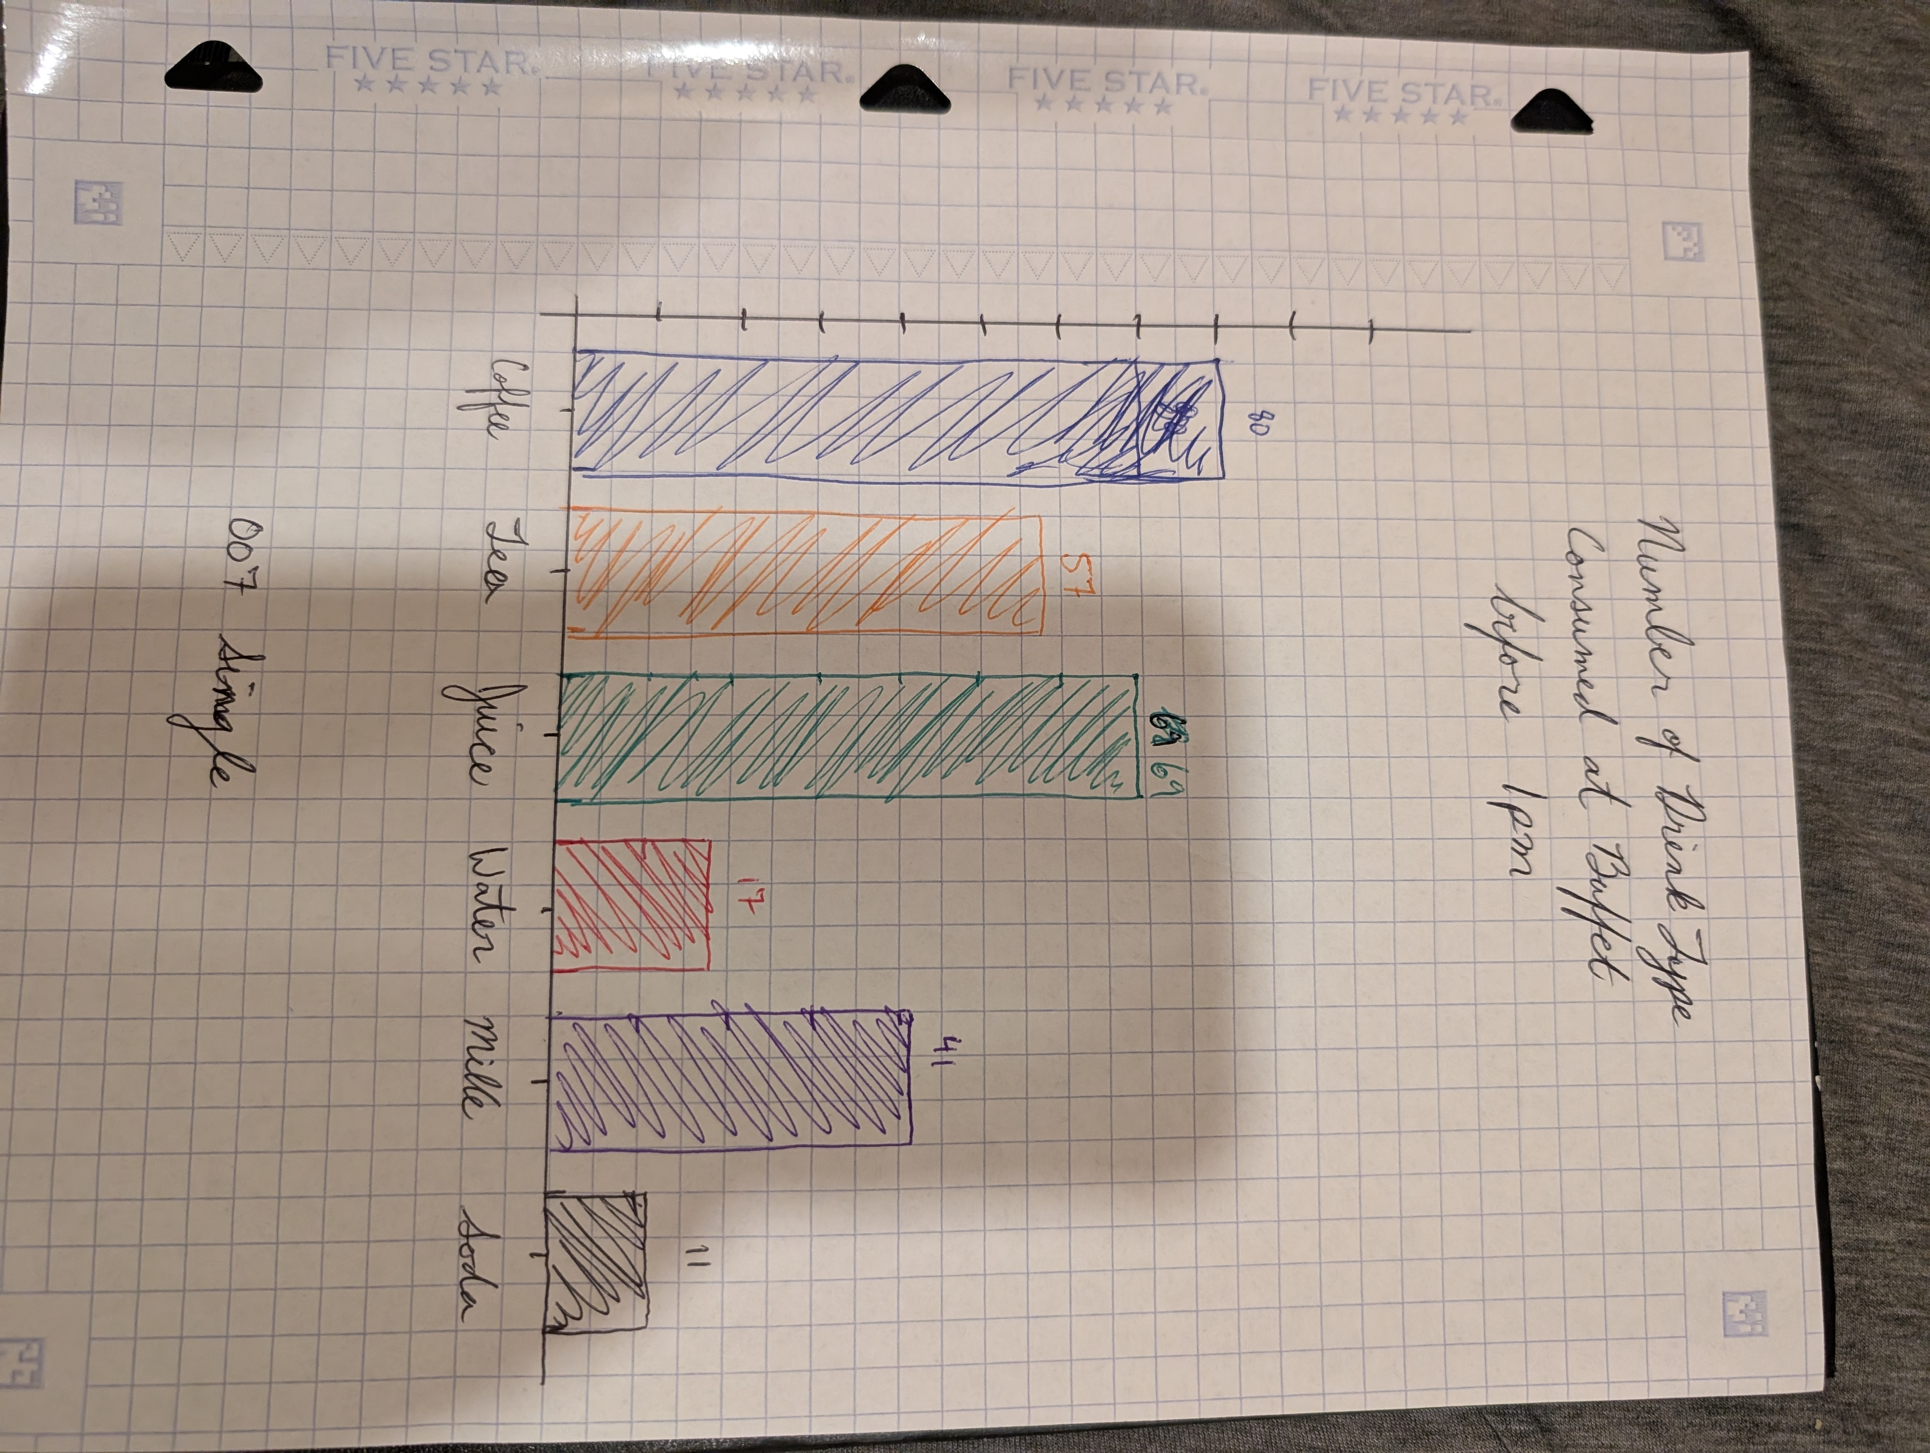
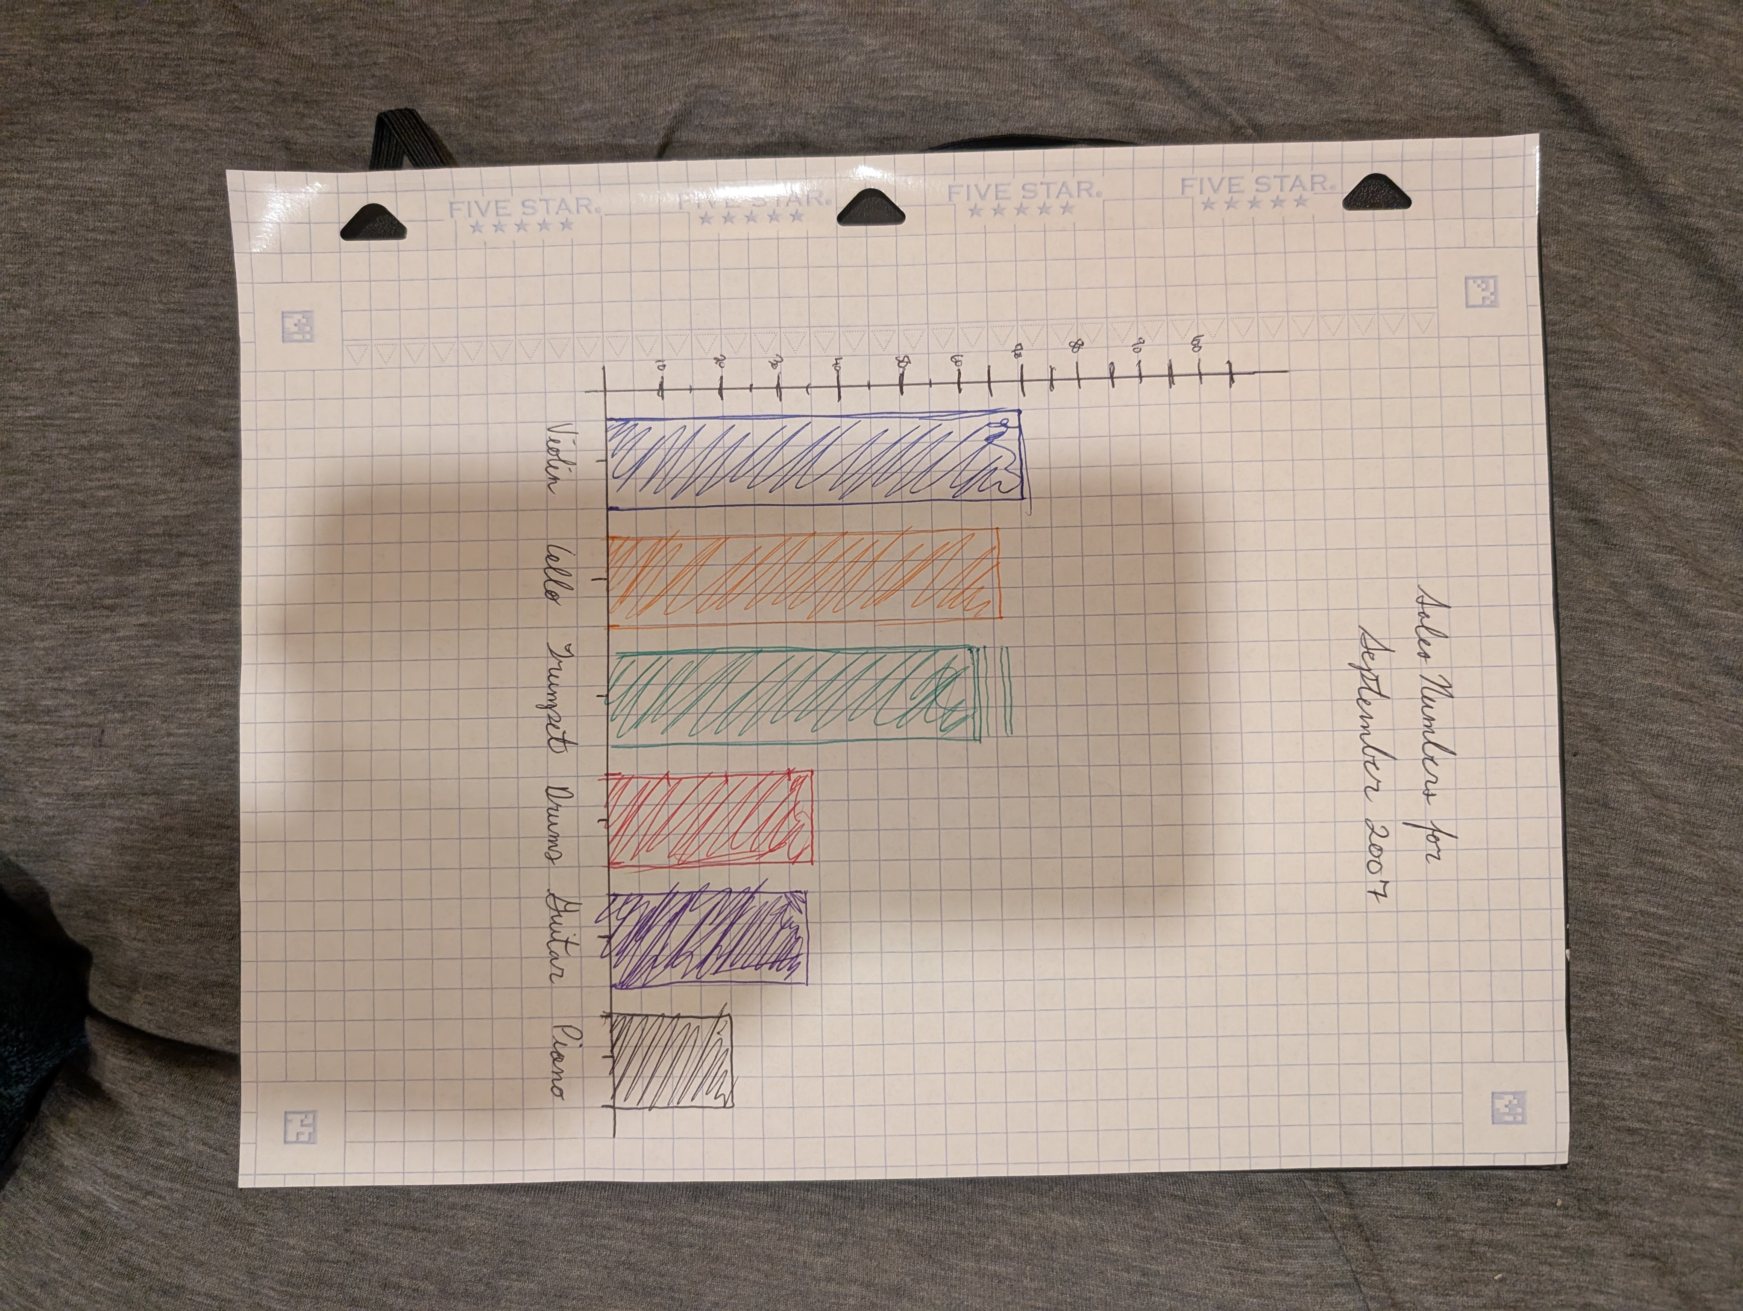
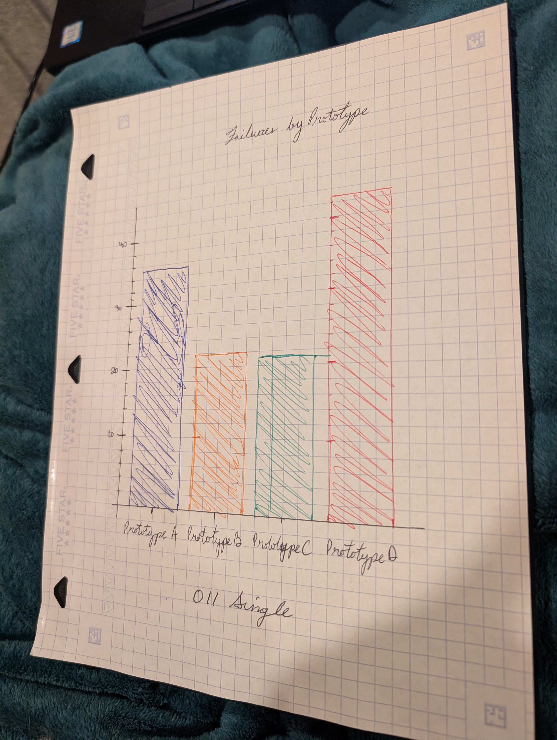
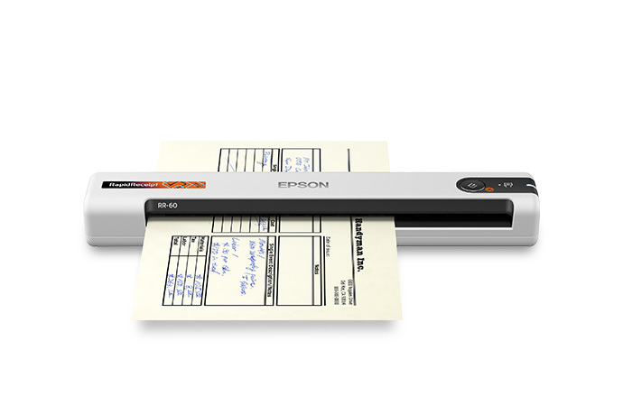
Data Sources
Training
The input files were just camera photos of my handwritten samples. I thought it would be easier to scan them in so that I wouldn’t have to rotate or crop to content. However, when I saw the price of a mobile scanner, like the Epson RR-60 ($199 CAD),
I decided to work on
the harder steps.
DD/MM/YYYY
Camera Images
DD/MM/YYYY
Feature Name/Product
Your Company Name

Slide 16
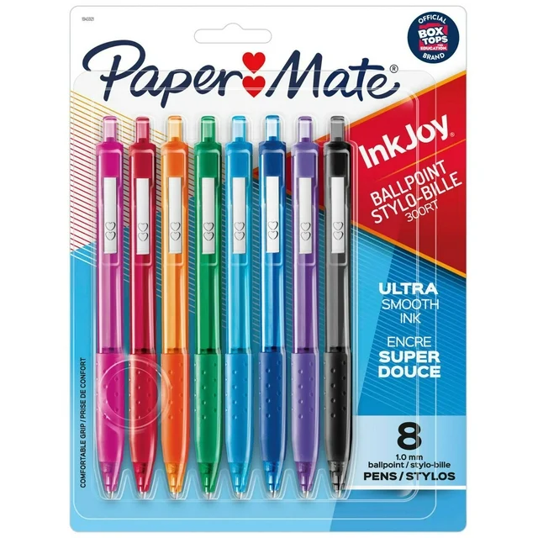
Data Sources
Training
Because I had saved money on the scanner, I decided to buy a $20 CAD set of gel pens for a consistent colour. My trip to Walmart proved much more fruitful than I could have imagined. More on that later….
DD/MM/YYYY
Camera Images
DD/MM/YYYY
Feature Name/Product
Your Company Name

Slide 17
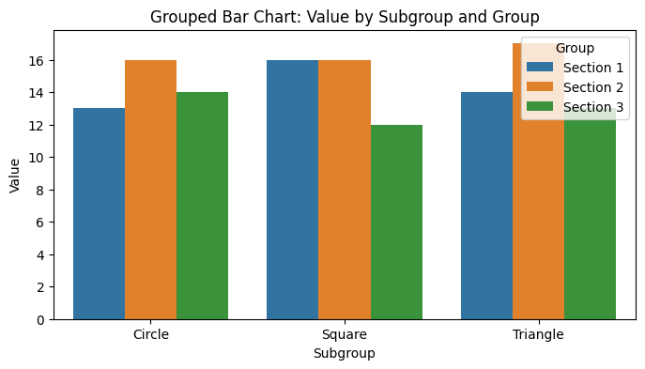
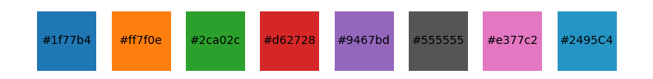
Data Sources
Training
Validation
I used a script to synthesize data, then I used Python libraries to make the bar charts from the CSV tables and I drew my notes from the same set of the CSV and saved the photos in the same name as the CSV and the barchart image.
DD/MM/YYYY
Corresponding Digital Charts
Comma Separated Lists with tabulated data
Barchart colour palette to match real-world pens
DD/MM/YYYY
Feature Name/Product
Your Company Name

Slide 18

Anatomy of a Piece of Paper
In the Stationary Aisle, while looking for pens, I stumbled upon Five Star’s latest paper. It’s meant for use with its “Study App” I was instantly fascinating with the features that I thought made this an effective medium.
DD/MM/YYYY
DD/MM/YYYY
Feature Name/Product
Your Company Name

Slide 19
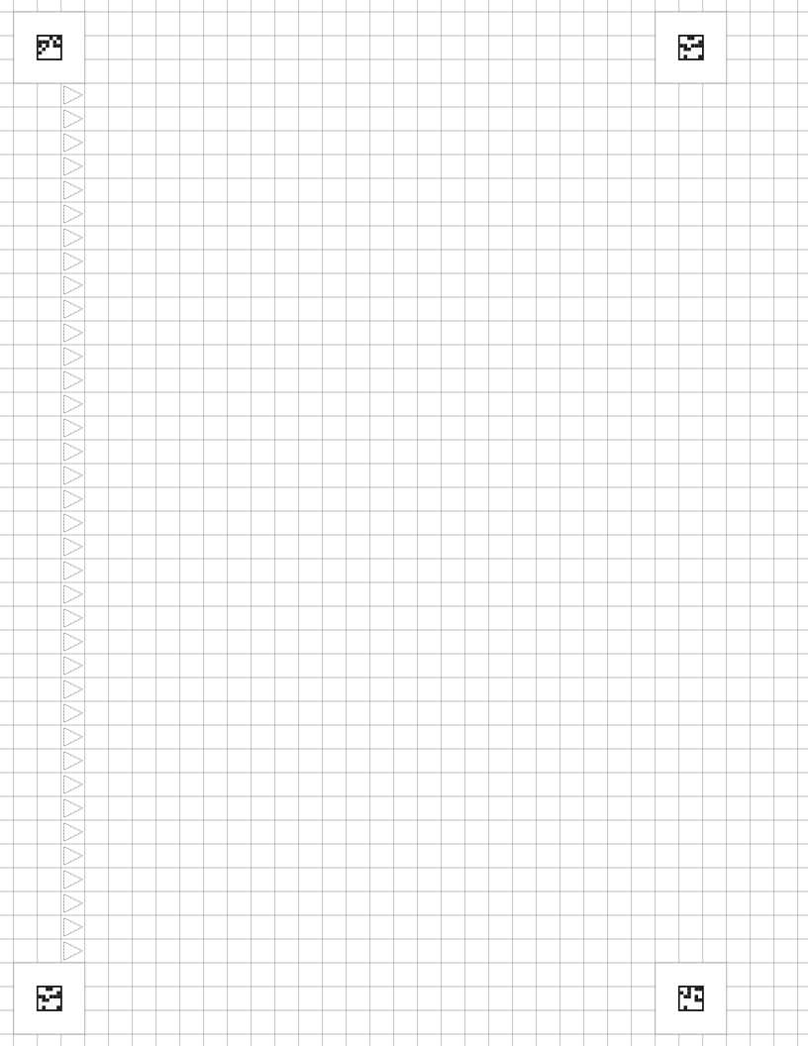
Anatomy of a Piece of Paper
I spent a day modelling the paper in Inkscape, a scalable vector graphics program that I have been using since 2015. The interesting features to me, as a data scientist, are the the quick calibration squares in the corners of each page and the directional arrows for calibrating page orientation.
DD/MM/YYYY
DD/MM/YYYY
Feature Name/Product
Your Company Name

Slide 20




Anatomy of a Piece of Paper
The quick calibration squares (QCS), featured here. There are four distinct QC squares and they are distinct, one from the others. Each is made up a 0.5mm border of black and a 6 by 6 pattern.
DD/MM/YYYY
DD/MM/YYYY
Feature Name/Product
Your Company Name

Slide 21
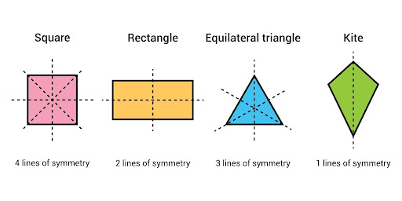
Anatomy of a Piece of Paper
It is my intuition that the pattern was specifically chosen to avoid axes of symmetry. As you can see in the image, 0/4 axes provide symmetry for any one the QCSs chosen.
DD/MM/YYYY
Axes of Symmetry per Geometric Shape
DD/MM/YYYY
Feature Name/Product
Your Company Name

Slide 22
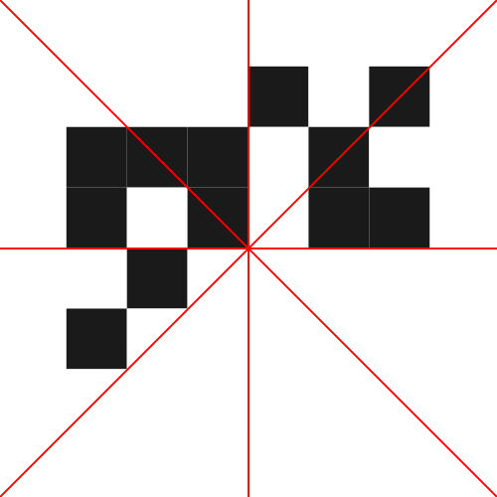
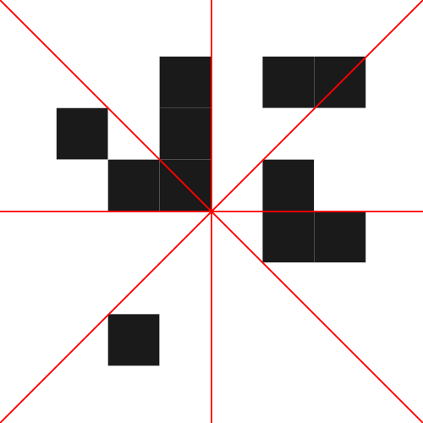
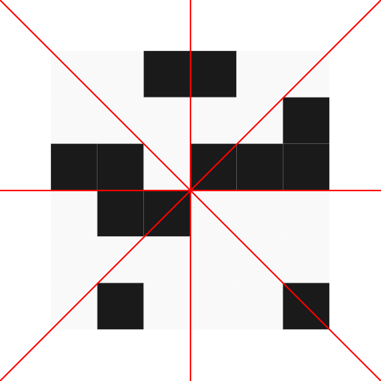

Anatomy of a Piece of Paper
Any way you cut and mirror, the squares, they are distinct from themselves. I wondered if they were perhaps a way to sign the paper digitally, but I have concluded that they are most likely not storing data, at least not anything useful to me.
DD/MM/YYYY
DD/MM/YYYY
Feature Name/Product
Your Company Name

Slide 23
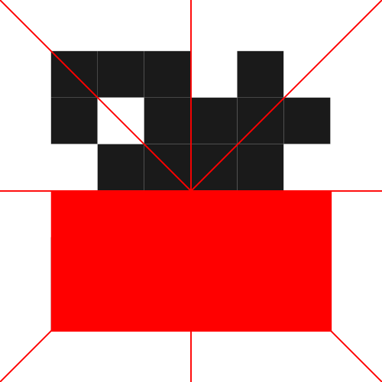
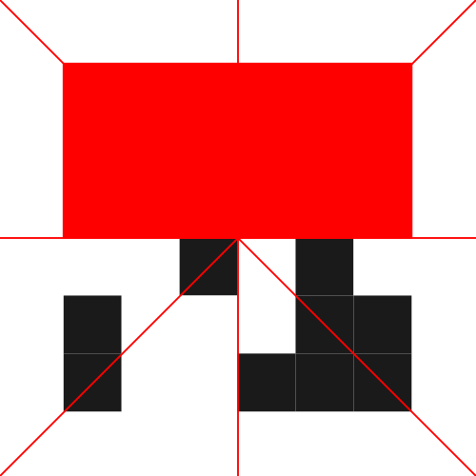
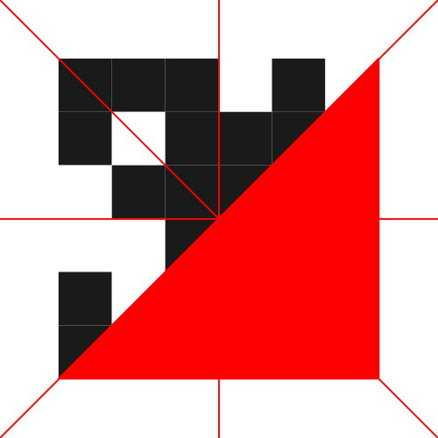

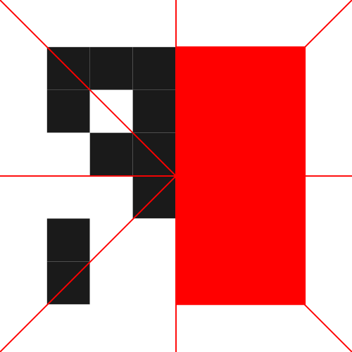
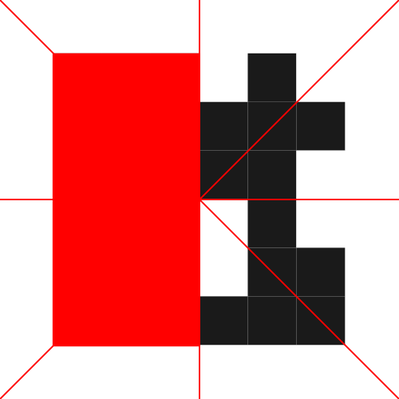


Anatomy of a Piece of Paper
DD/MM/YYYY
Feature Name/Product
Your Company Name

Slide 24
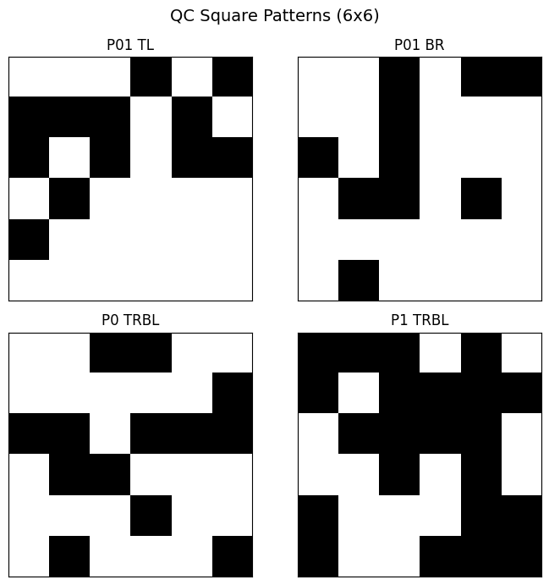
Anatomy of a Piece of Paper
I labeled the front of the page “Page 1” and the back of the page “Page 0.” Therefore, as you can see in the picture, the 4 QCS:
- Page 0 and Page 1 Top Left QCS are the same
- Page 0 and Page 1 Bottom Right are the same
- Page 0 Top Right and Bottom Left are the same
- Page 1 Top Right and Bottom Left are the same
DD/MM/YYYY
DD/MM/YYYY
Feature Name/Product
Your Company Name

Slide 25
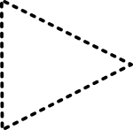
Anatomy of a Piece of Paper
The other calibration feature that is on the paper is a column of triangles. Upon measuring, I determined that these triangles are isosceles and not equilateral. This makes a slight difference for determining the skew of the paper.
DD/MM/YYYY
DD/MM/YYYY
Feature Name/Product
Your Company Name

Slide 26
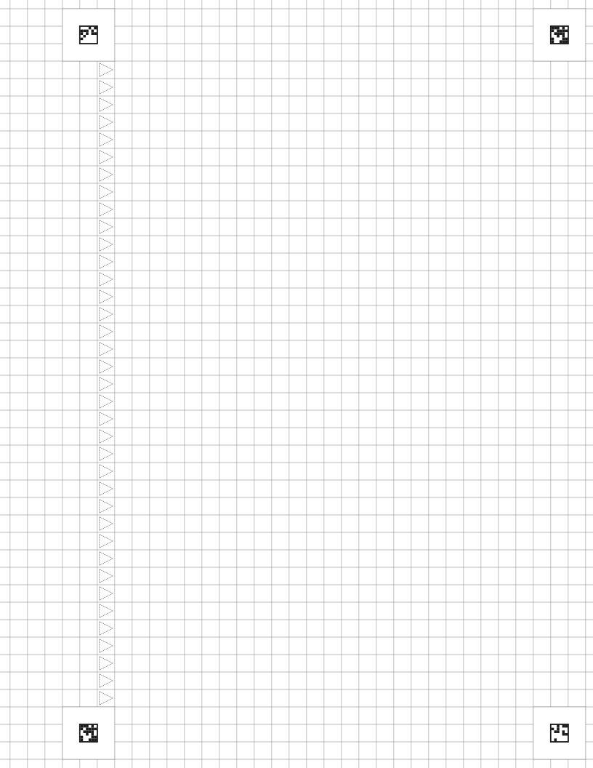
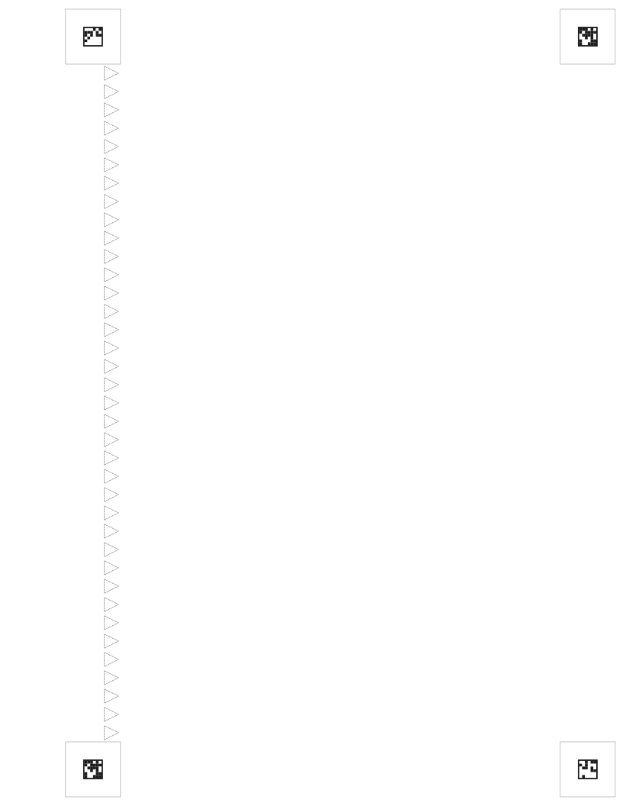

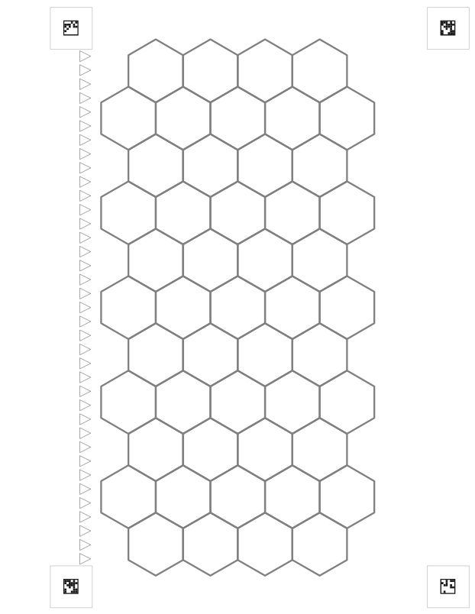

Anatomy of a Piece of Paper
After returning from the lengthy rabbit trail about the calibration features, I ended up with a few working paper styles that I might want to use:
- graph
- blank
- dot matrix
- hexed (for war board games)
- lined
DD/MM/YYYY
DD/MM/YYYY
Feature Name/Product
Your Company Name

Slide 27
03
Evaluation Techniques

Slide 28
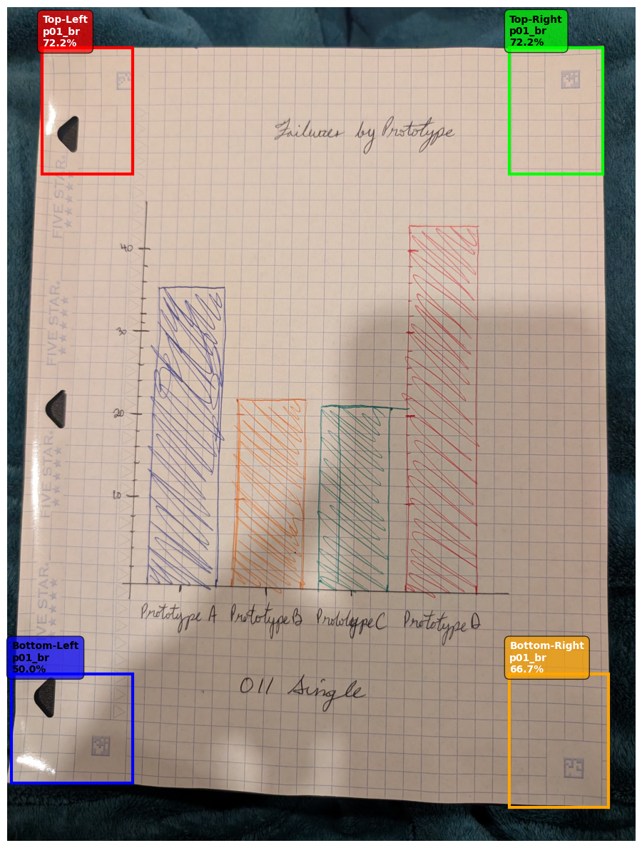
Page Corner Search Metric
Example
The measurement of accuracy is defined as:
# Sort by area (largest first) and prefer more square-like shapes square_candidates.sort(key=lambda x: x['area'] * x['solidity'], reverse=True)
Note: you can find this on 111 and 112 of Page Dimensions
DD/MM/YYYY
DD/MM/YYYY
Feature Name/Product
Your Company Name

Slide 29
Page Corner Search Metric
Example
The pattern detection uses a KNN algorithm to search for the pattern. I would probably improve this with more finely labelled examples. In the current state, the normalization process fails at the smallest deviation from the near-perfect individual sample. On some individuals, I was able to capture 3 of 4 corners, but then the auto-crop and rotate functions broke because I required 4.
DD/MM/YYYY
DD/MM/YYYY
Feature Name/Product
Your Company Name

Slide 30
Page Corner Search Metric
Example
The pattern detection uses a KNN algorithm to search for the pattern. I would probably improve this with more finely labelled examples. In the current state, the normalization process fails at the smallest deviation from the near-perfect individual sample. On some individuals, I was able to capture 3 of 4 corners, but then the auto-crop and rotate functions broke because I required 4.
DD/MM/YYYY
DD/MM/YYYY
Feature Name/Product
Your Company Name

Slide 31
04
Timelines

Slide 32
Original Timeline
Week | Milestone
1 | Finalize annotation schema, label initial dataset.
2 | Implement normalization prototype, integrate baseline handwriting OCR and chart classifier; evaluate on sample pages.
3 | Deploy element detectors and table recognizer; stand up Markdown/CSV writers.
4 | Iterate on semantic assembly, run core evaluations, and prepare presentation materials.
Current
DD/MM/YYYY
Feature Name/Product
Your Company Name

Slide 33
Updated Timeline
Development | Testing | Implementation | Production
Page Design
Computer Vision Functions
Anti-Cheat Features
Sample Synthesis
Page Cropping and Rotating Functions
DD/MM/YYYY
Feature Name/Product
Your Company Name

Slide 34
Project Conclusion
I am still working on the calibration of page detection so that I can normalize the image and crop to the content. The normalization step is important because it helps the next step detect the sizing of bar charts.
DD/MM/YYYY
Feature Name/Product
Your Company Name

Slide 35
-- But wait, there’s more!
While teaching my niece about Music Theory and putting together a worksheet for her, my muse visited me.
DD/MM/YYYY
Feature Name/Product
Your Company Name

Slide 36
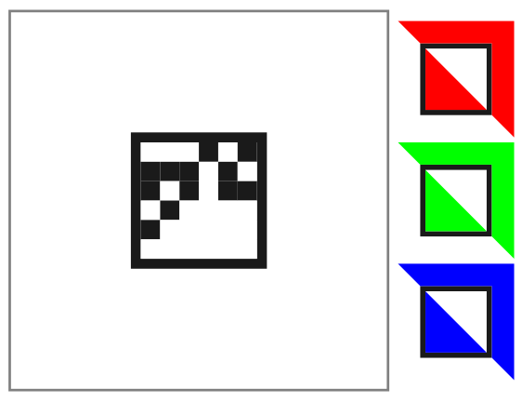
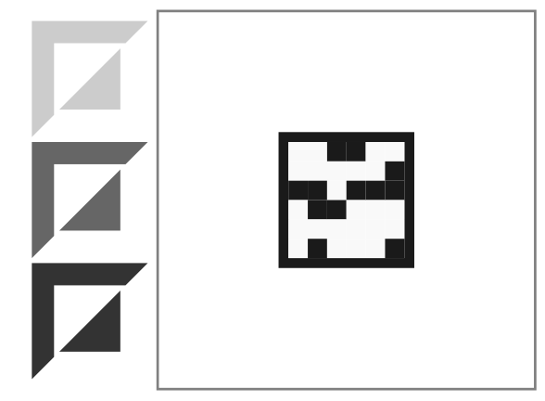
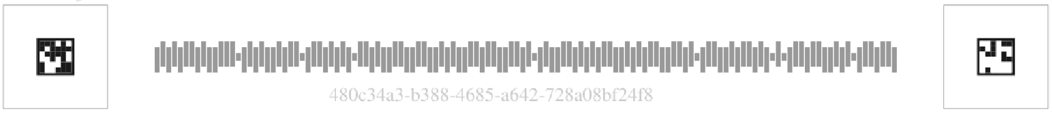
The Anti-Cheat Paper of the Future
Using Python, I created a PDF maker that signs each page of a book with a watermark so that it can be analysed for tampering or cheating. New features include an AUSPost Barcode, RGB and Greyscale calibration squares. The PDF maker works on existing PDFs, signs each page, and logs the signature for future reference.

Slide 37

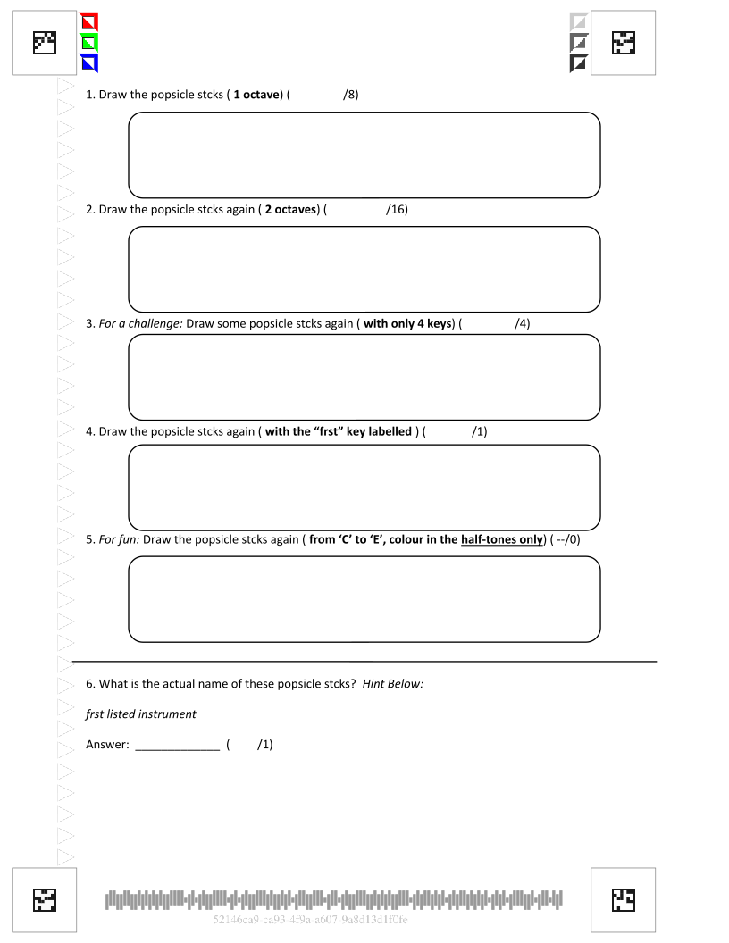
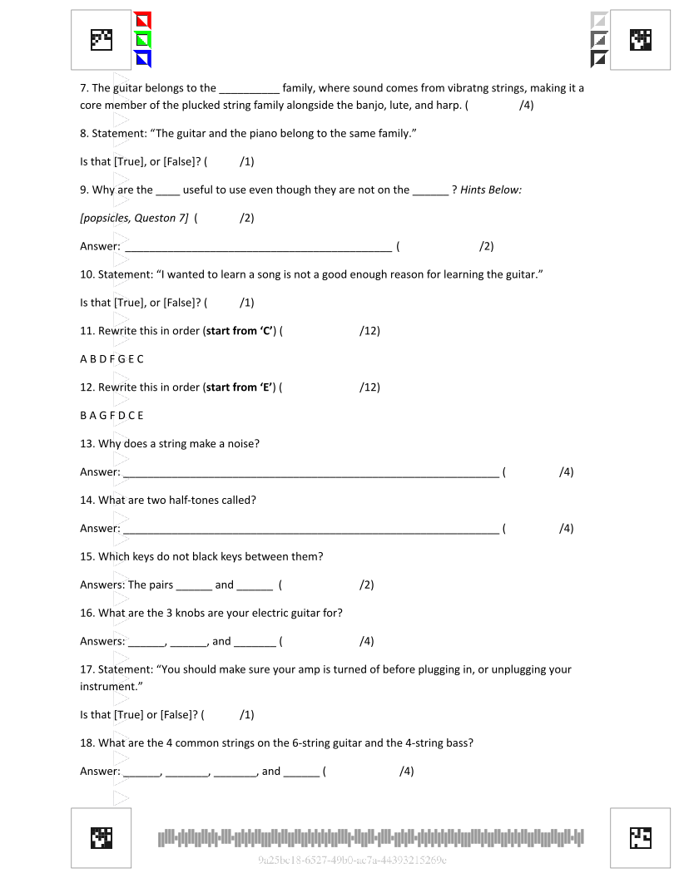
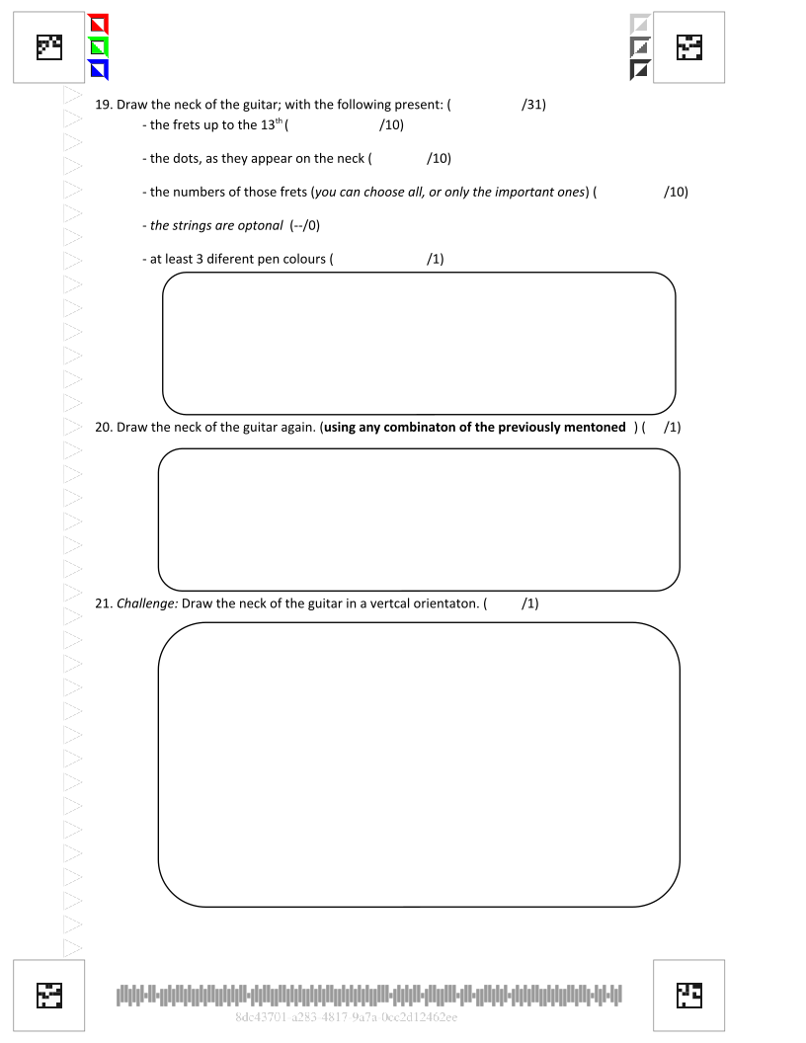
Some information can be stored in the barcode, like page orientation, answer areas, grades, etcetera.
In this way, the paper would help me grade papers in the future. If I were to expand the pipeline to include an analysis per answer with feedback, I could auto-grade sheets at scale.
I would also have a quick reference of images to use for hand-writing forgery tests against in-person exams.

Slide 38
Conclusion
I never thought I would get so nerdy about paper. But this is a very exciting problem for me to tackle. I will continue to work on the original use-case because I think that it has applications in my current job for automation. I will likely use the other fruits of my labour for passion projects outside of work, like teaching and my own creative writing.
DD/MM/YYYY
Feature Name/Product
Your Company Name

Slide 39
Thanks!
Do you have any questions?
chris@brechin.services
https://brechin.services
Feature Name/Product

